Slide 1

Midterm Presentation
Triton Robotics
University of California, San Diego

Slide 2
Table of Contents
Infantry
Hero
Sentry
Engineer
Drone
Dart
Embedded
Computer Vision
SuperCapacitor
Notes:
Usually, we would walk you through the Dev Board for blinking LEDs, PWM signals etc but being virtual makes that extremely difficult

Slide 3
Infantry

Slide 4
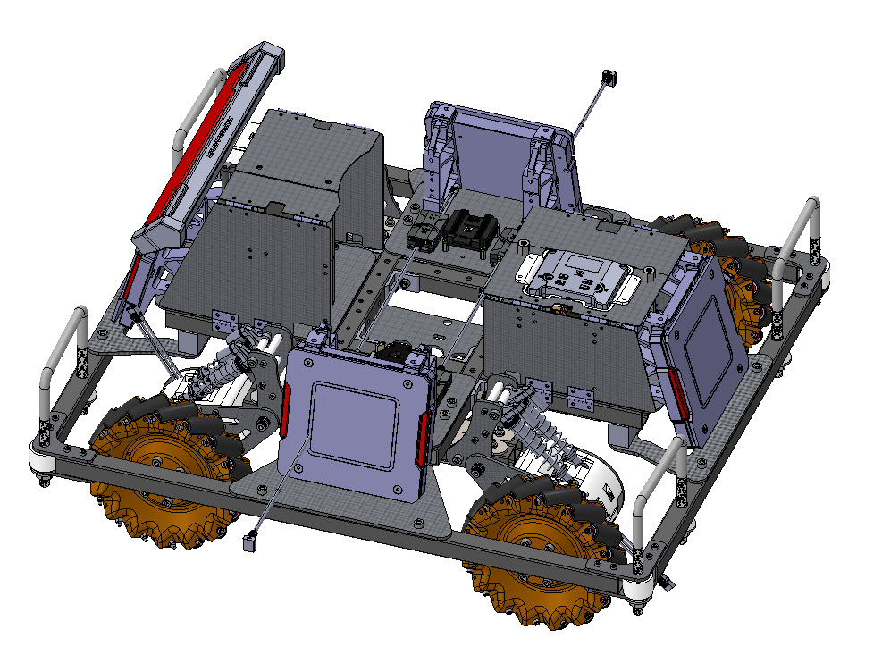
CAD Design - Chassis
Chassis
Capability:
Protection for and Easy Access of Electronics
Relatively stable under violent crash
Roller on corners of chassis to prevent getting stuck in arena corners
U-bolts for Rescue Mechanism
To be improved:
Wire Management (tried using cable clips to ameliorate)
Reduce Size

Slide 5
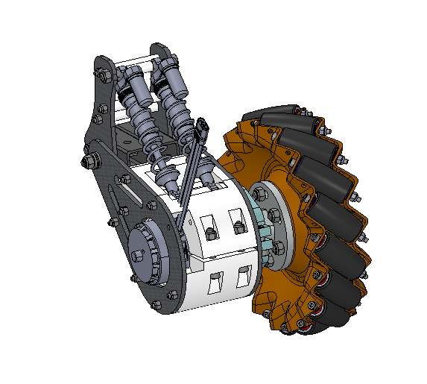
CAD Design - Suspension
Suspension
Capability:
Reduces Vibration during Movement (Especially in Front and Back Translational Movement)
Keeps Mecanum Wheels on Ground
Ease of Mounting to Chassis
To be improved:
Modularity (tried using press-fit nuts to reduce quantity of fasteners)

Slide 6
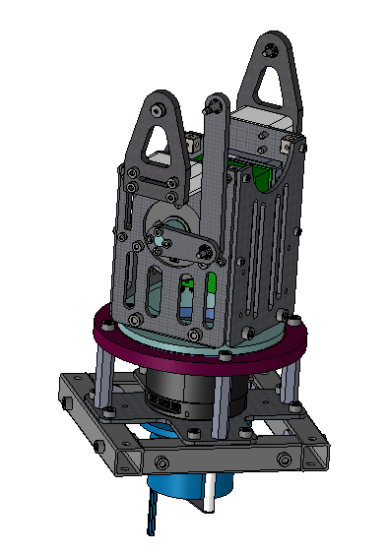
CAD Design - Turret Base
Turret Base
Capability:
Allows Rotation of Chassis Relative to Turret with Slip Ring
Ease of Access of Electronics
Reduced Moment of Inertia due to New Pitch Motor Position
To be improved:
Reduce number of fasteners (trying to include tapped holes in machined parts)

Slide 7
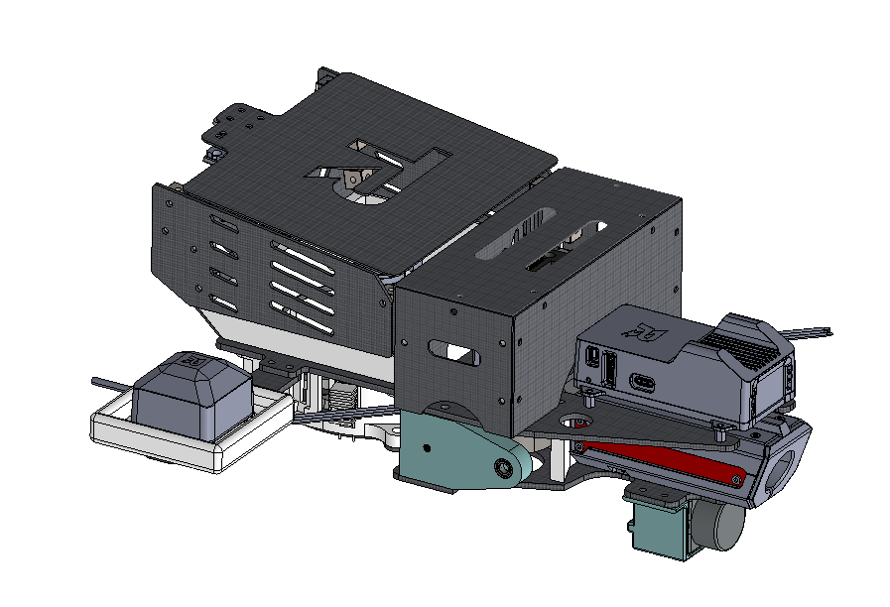
CAD Design - Turret
Turret
Capability:
Holds Ammo and Shoots Projectiles
Protection of Electronics
Servo-Powered Lid
To be improved:
Wire Management
Reduce Jamming of Projectiles

Slide 8
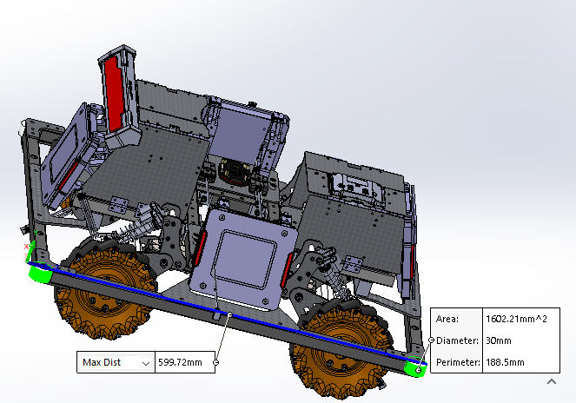
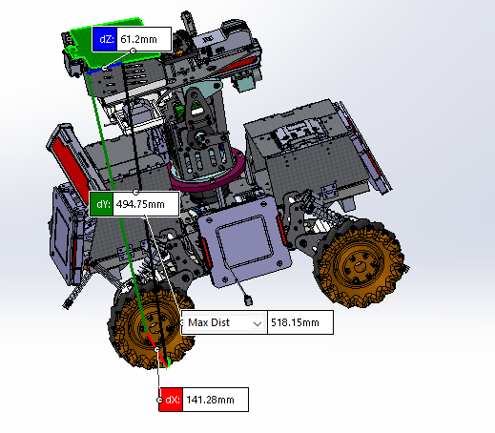
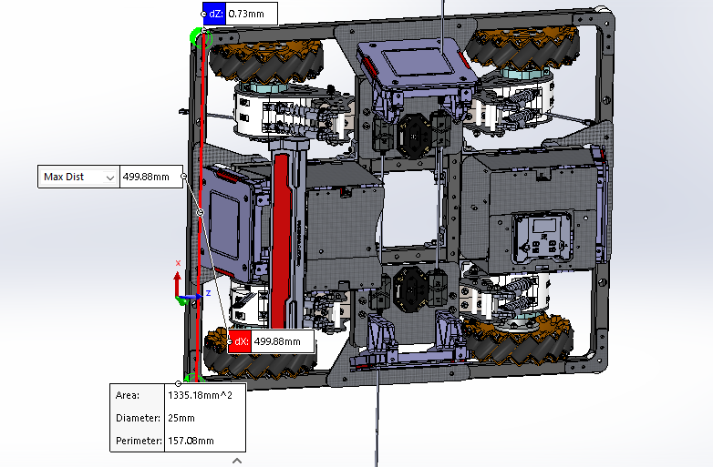
Dimensions
(L,W,H): (599.72, 499.88, 518.15) mm

Slide 9
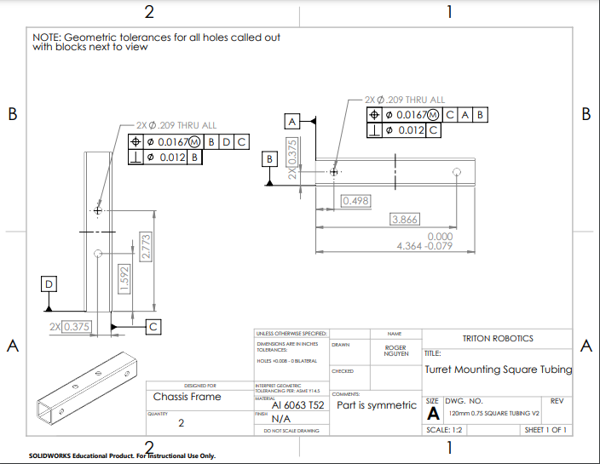
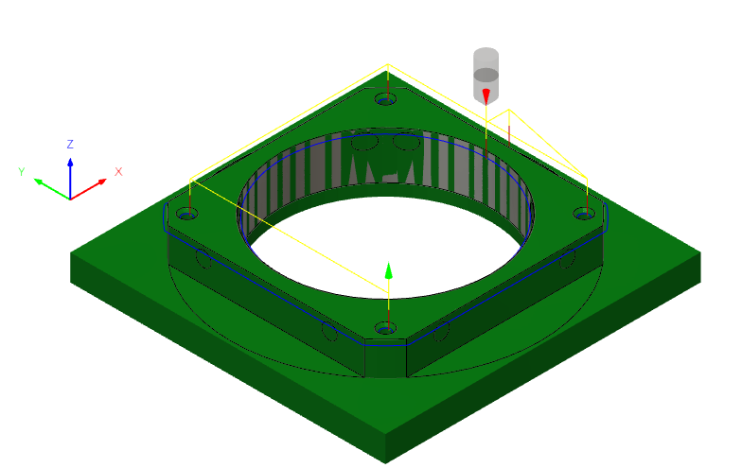
Manufacturing Showcase
Drawing for Milling
Program for CNC Milling

Slide 10
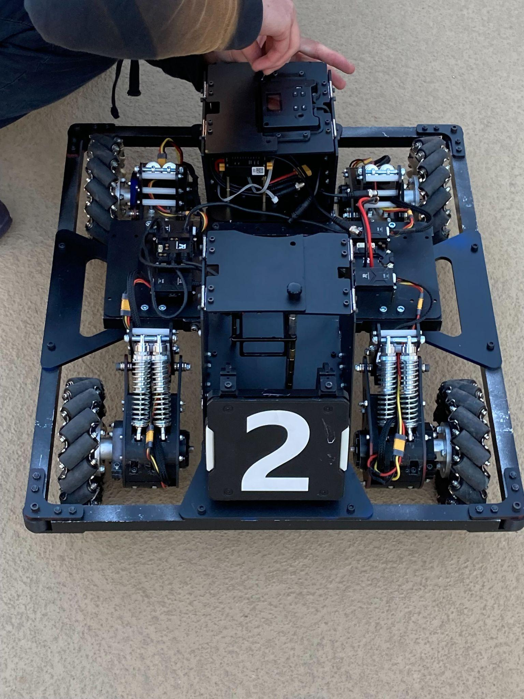
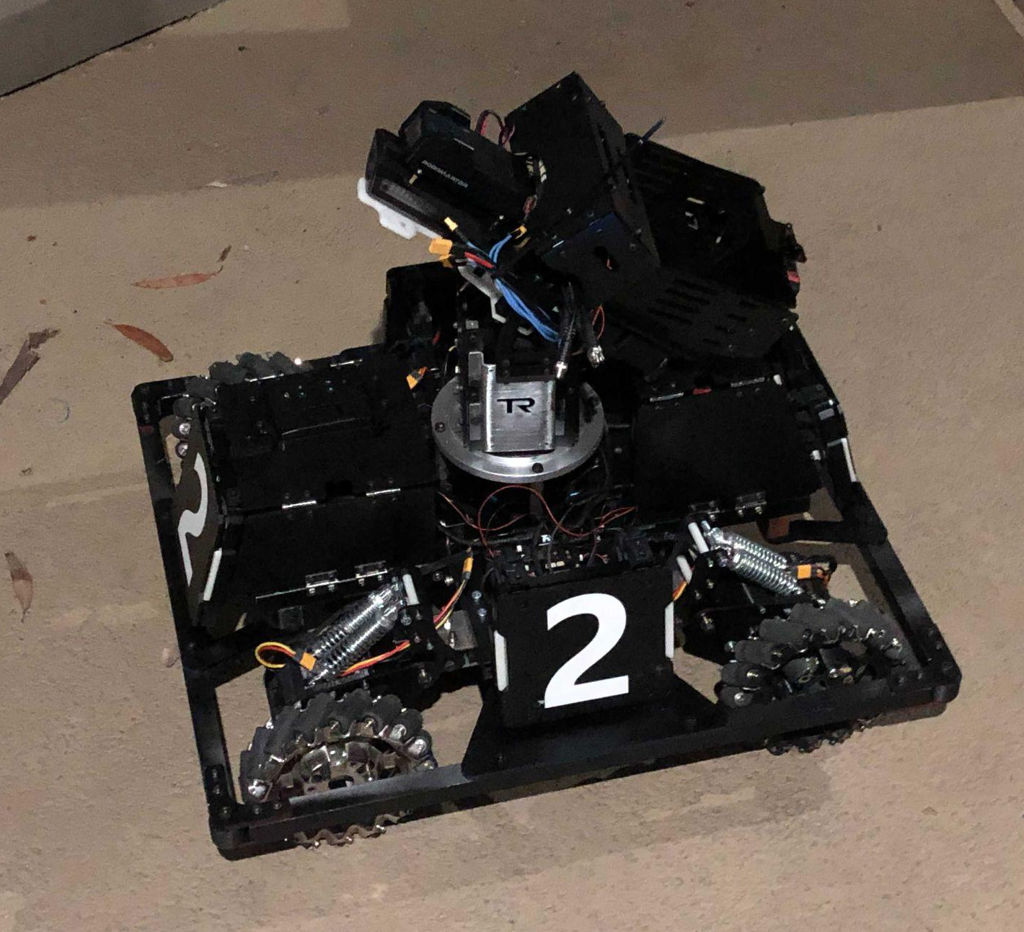
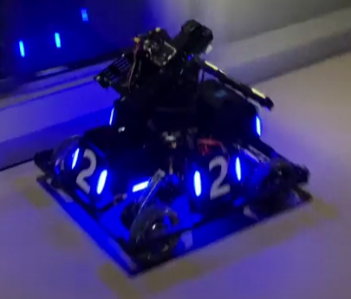
Physical Model Showcase
Robot without Turret
Full Robot
Full Robot Online

Slide 11
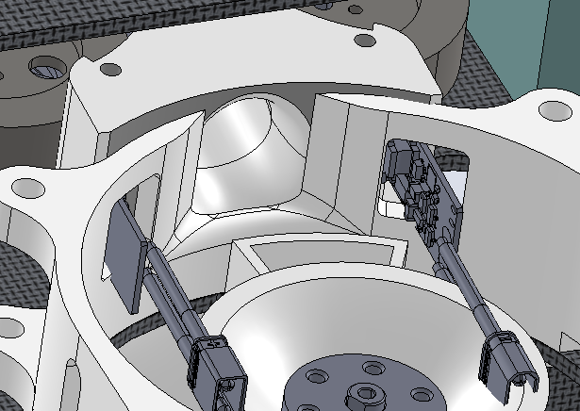
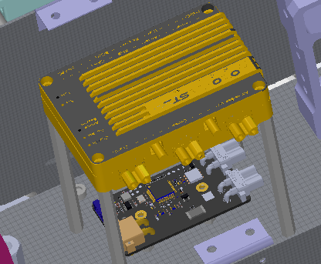
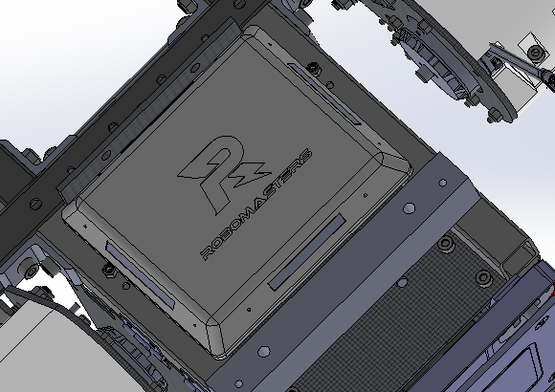
Referee System Showcase
4 armor plates + 1 HP Bar
17mm Speed Monitor + VTM
GPS
Fluorescent LED Driver
Main Control Module
PMM + SuperCap Module
RFID

Slide 12
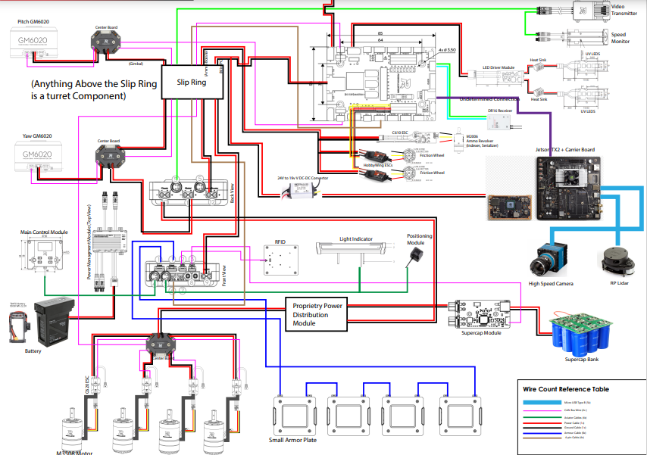
Wiring Diagram Showcase

Slide 13
Hero

Slide 14
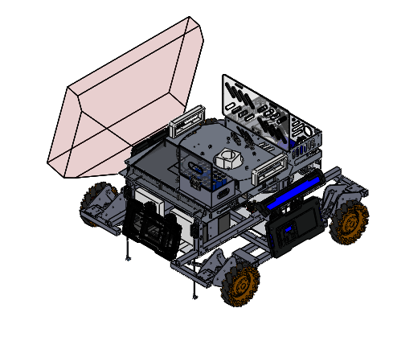
CAD Design - Chassis
Chassis
Capability:
Easy access to internals
Experimental suspension design for versatile movement
Store 45 42mm rounds
To be improved:
Wiring and electronic mount
Reduce size/weight
Suspension

Slide 15
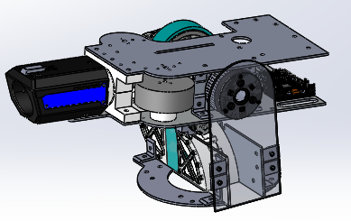
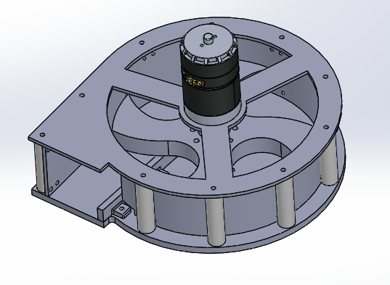
CAD Design - Gimbal/ Serializer
Gimbal
Capability:
Shoots 42 mm rounds
Bottom feed ammos
To be improved:
Add secondary 17mm turret above
Reduce friction/ increase strength of serializer (use different material)

Slide 16
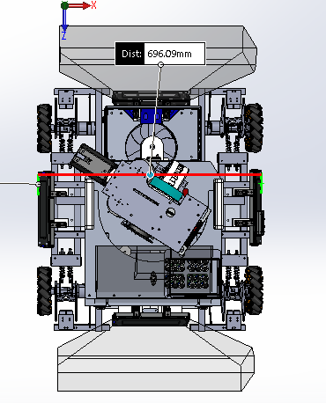
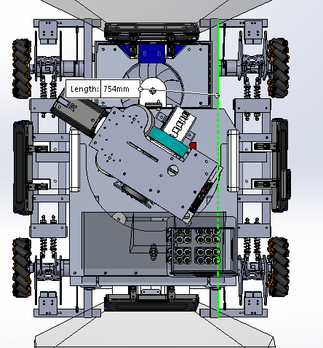
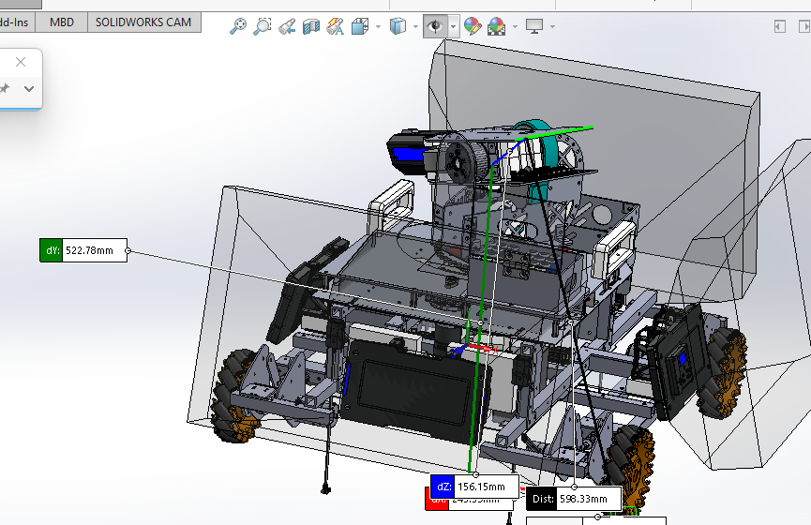
Dimensions
754x694.5x522.78 LWH

Slide 17
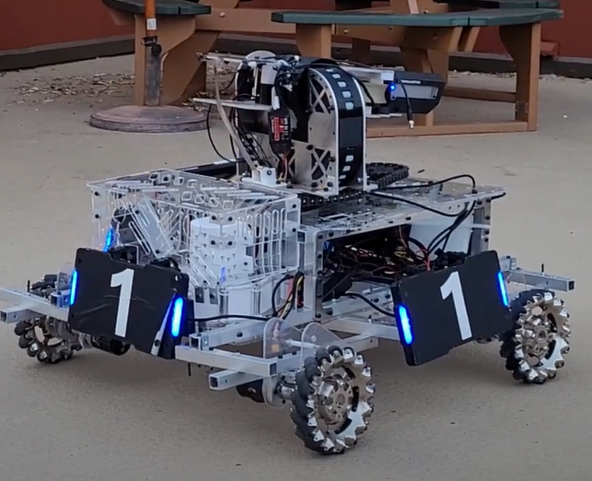
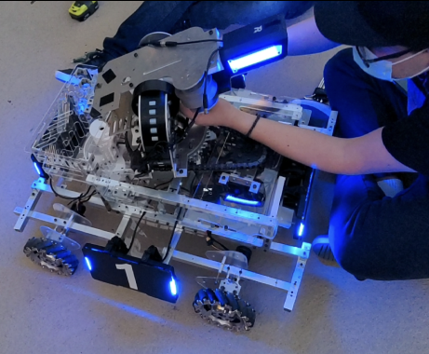
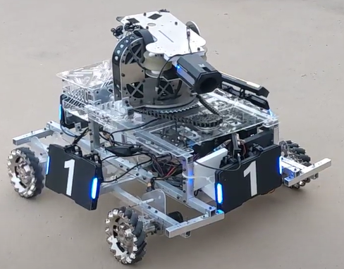
Hero Prototype

Slide 18
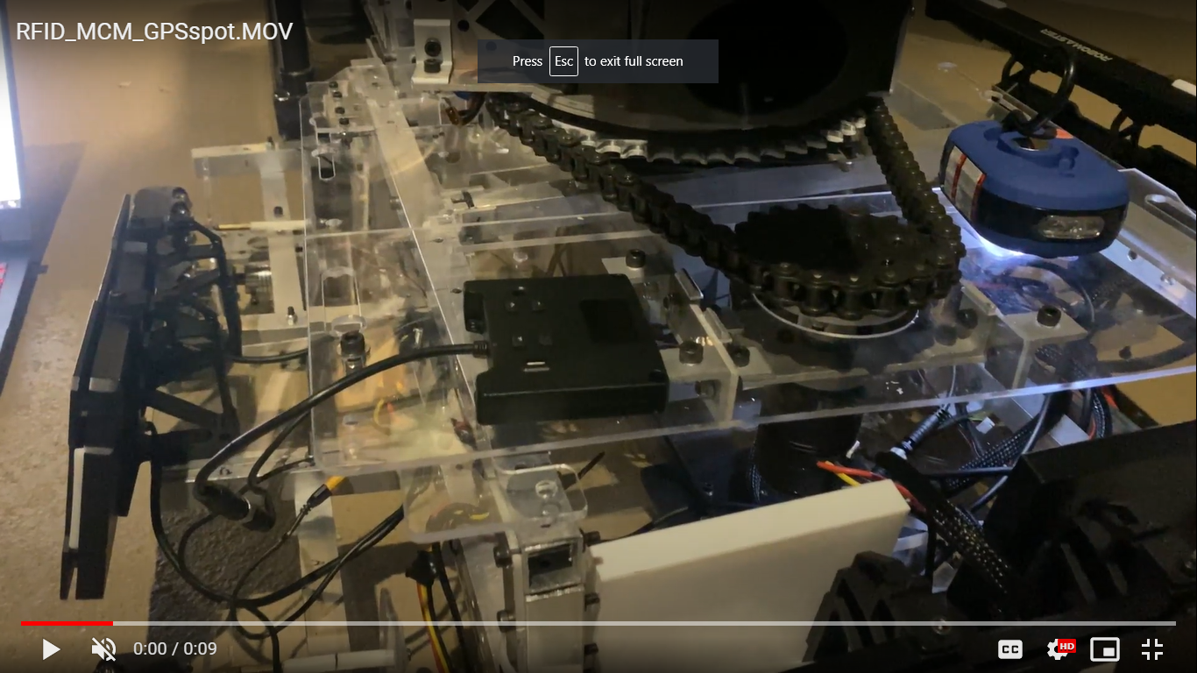
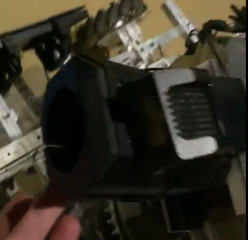
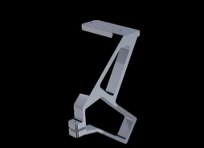
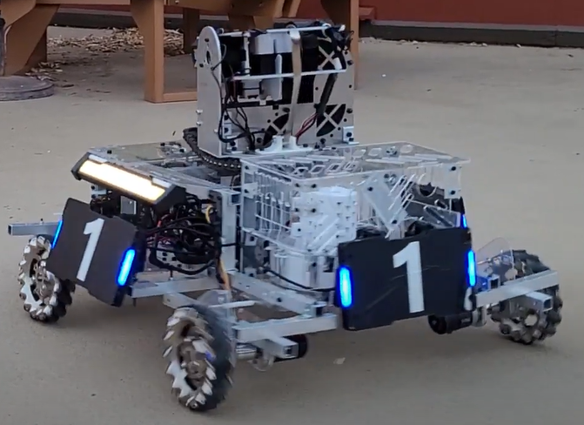
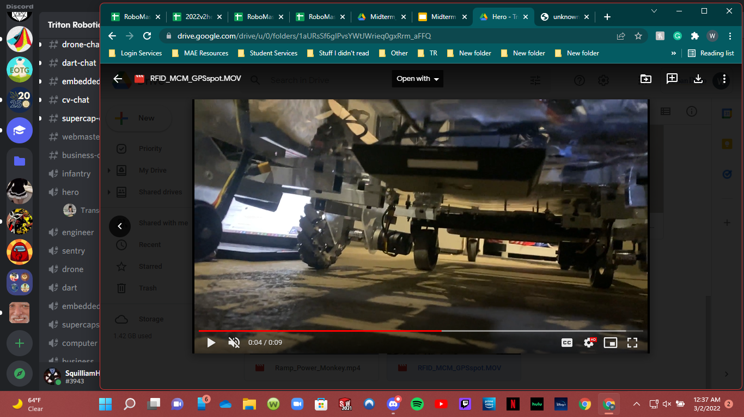
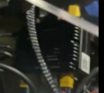
Hero Referee System
Main Control Module
42mm Speed Monitor & Transmitter
Positioning System mount
4 Large Armor Modules & Light Indicator
Power Management Module
RFID Module

Slide 19
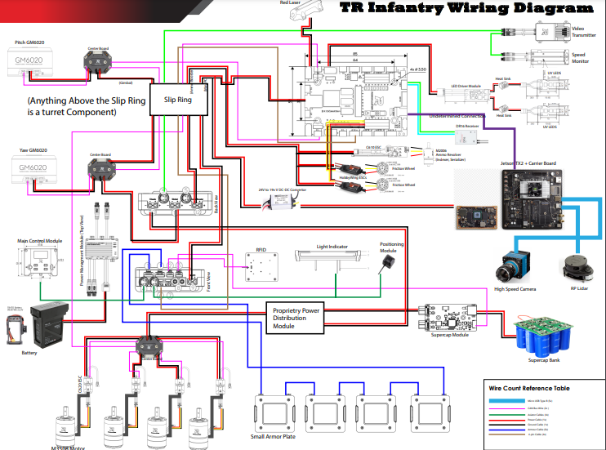
Wiring Diagram
Hero

Slide 20
Sentry

Slide 21
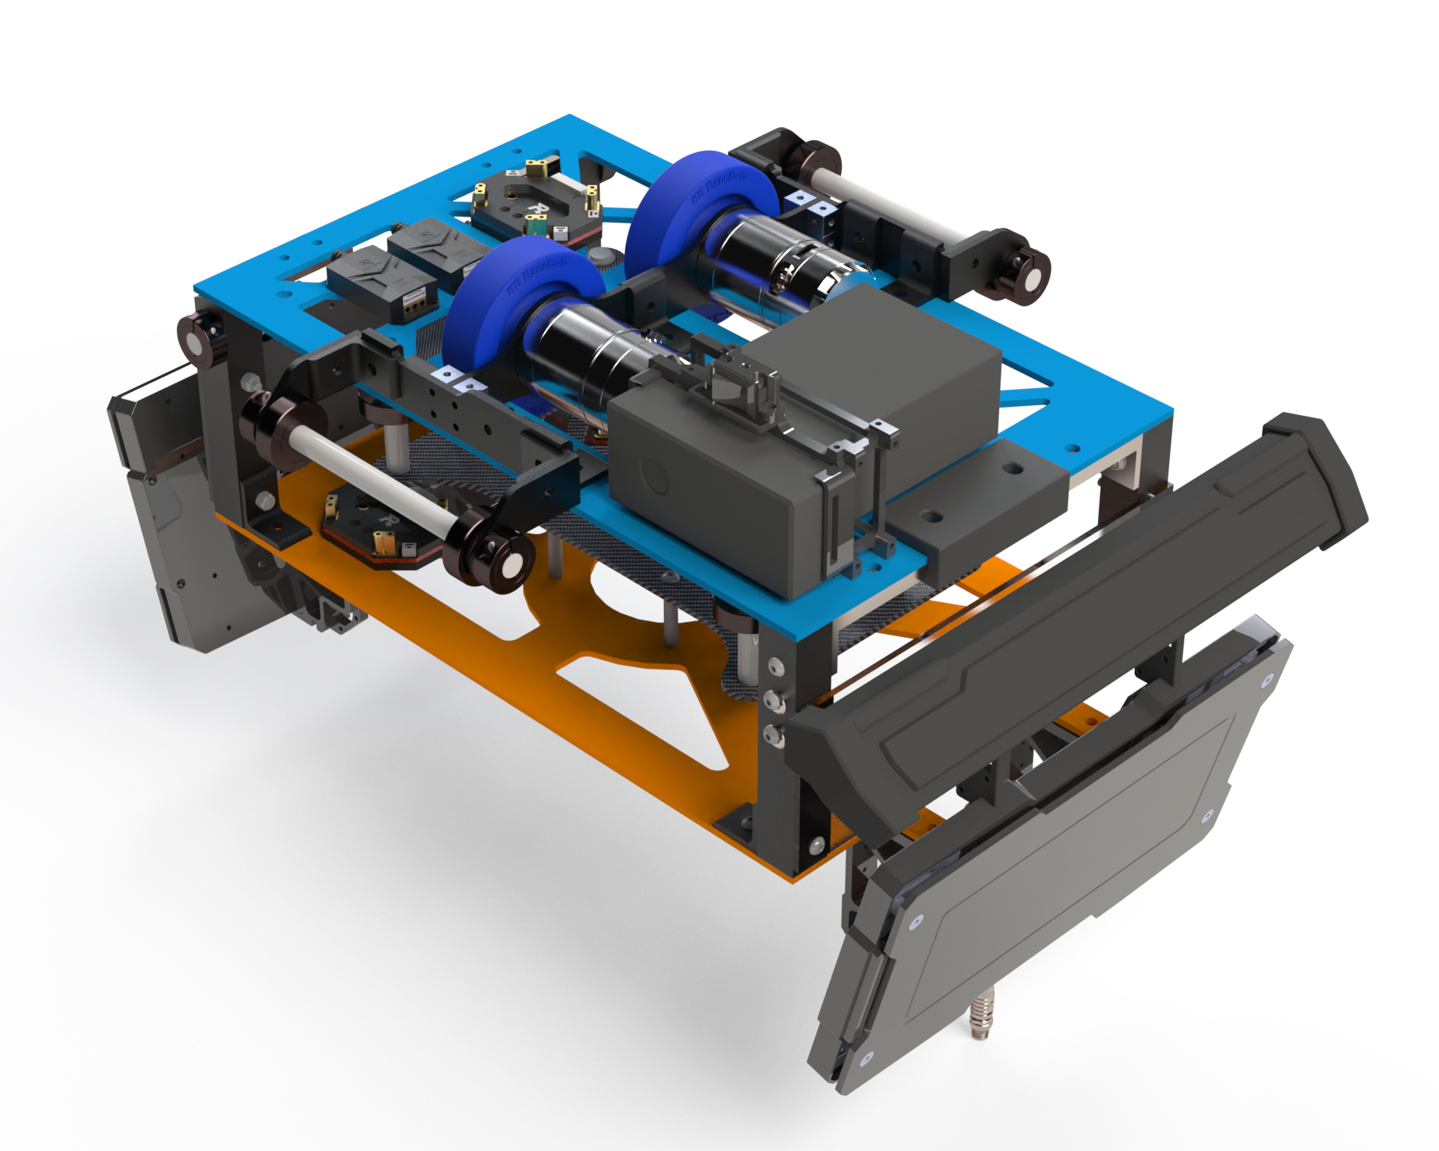
CAD Design -Chassis
Chassis
Capability:
Smooth movement along rail
Easy access to electronics
Easy attachment/detachment from rail
To be improved:
Side rollers need to be adjustable

Slide 22
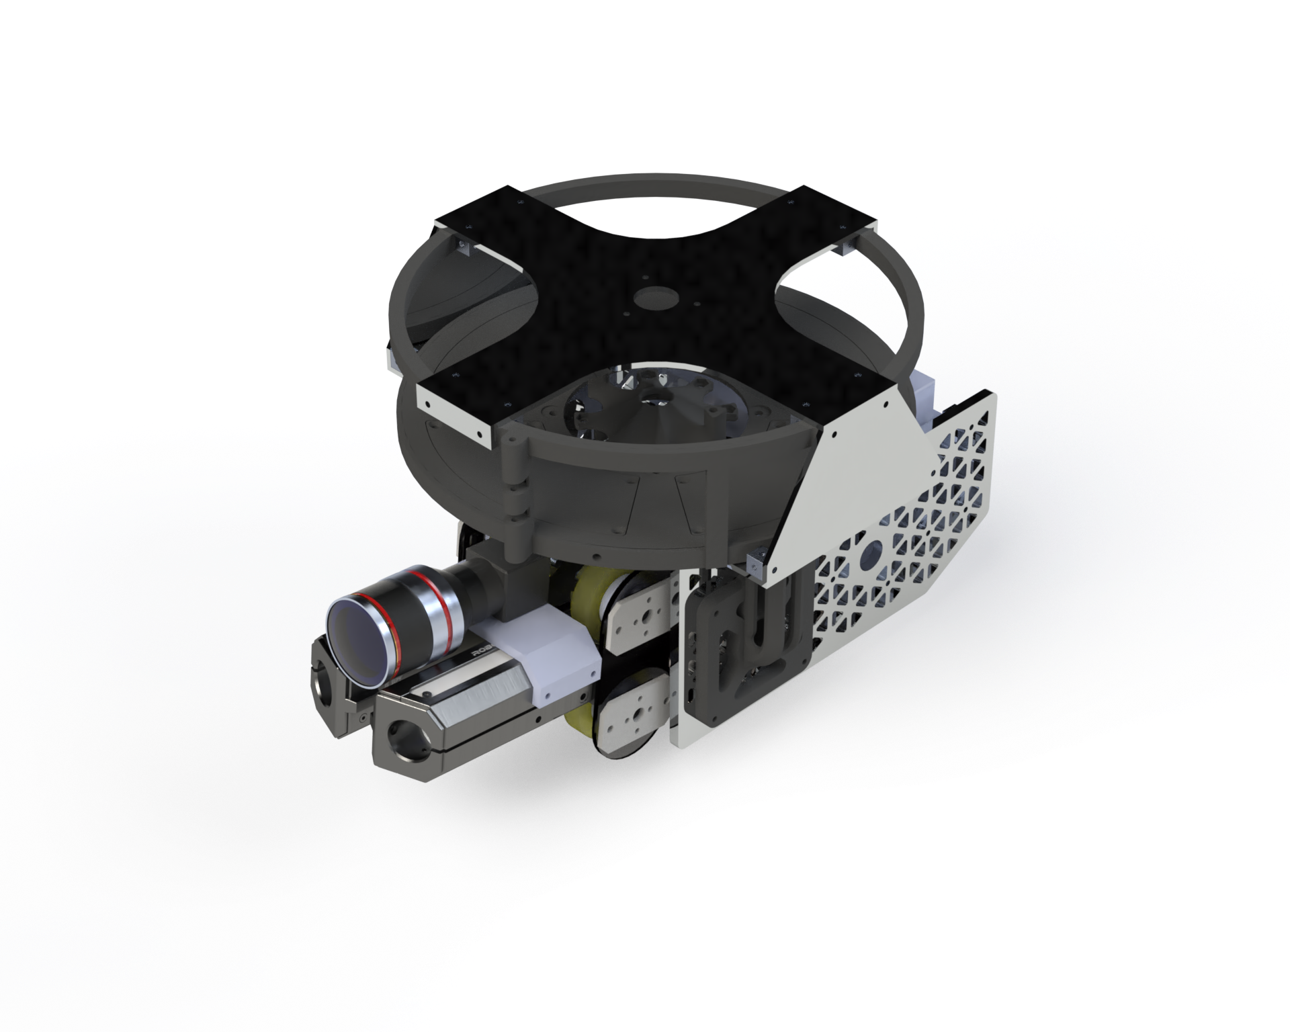
CAD Design -Turret
Chassis
Capability:
Dual Barrel Shooting
Compact lightweight design
Full 500 ammo capacity
To be improved:
Eliminate Indexer jamming
Ammo storage accessibility

Slide 23
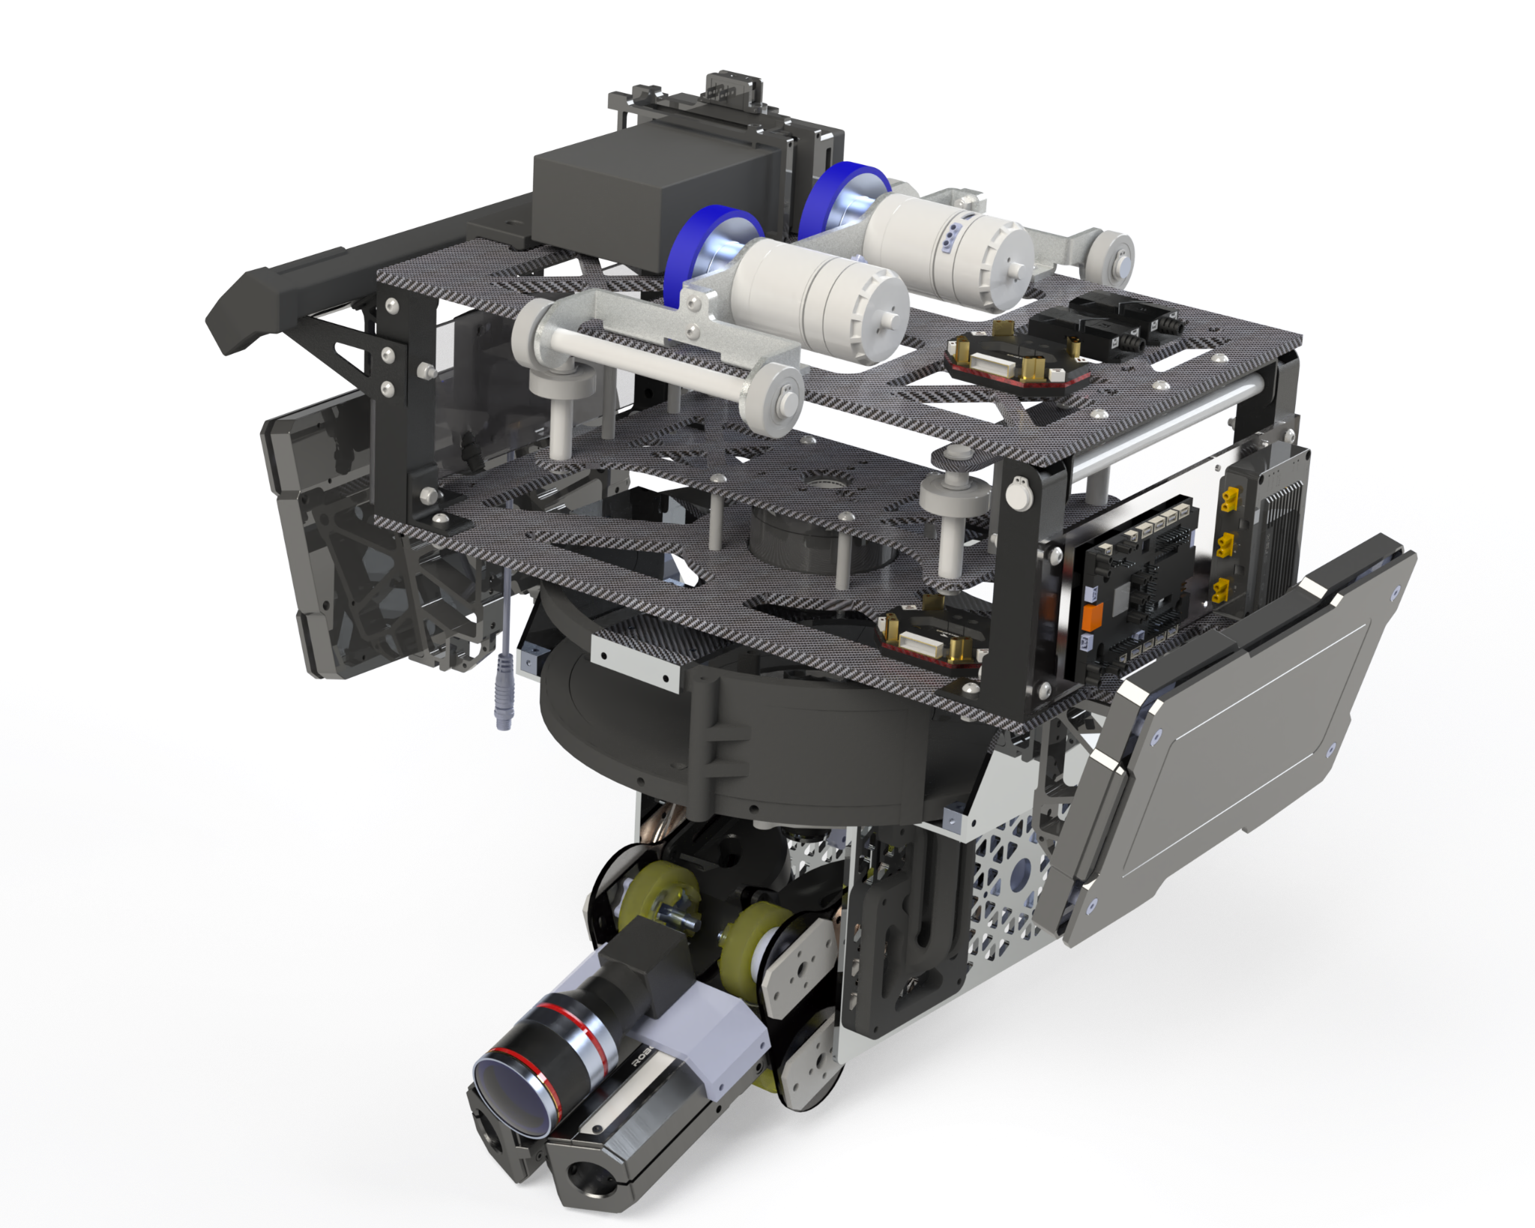
CAD Design -Sentry
Chassis
Capability:
Fits all sizing requirements
Fast and agile movement
To be improved:
Integration of slip ring

Slide 24
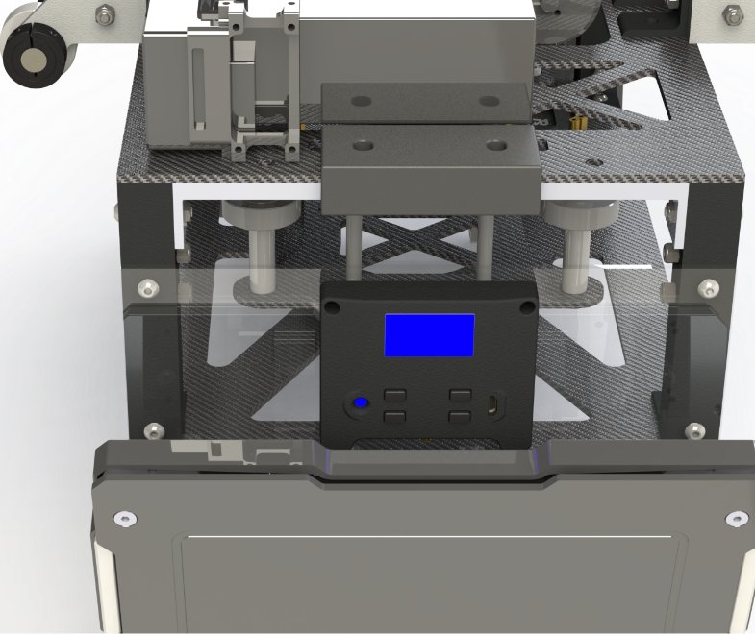
Referee System Showcase
Power Management Module
17mm Speed Monitor Module
Main Control Module

Slide 25
Engineer

Slide 26
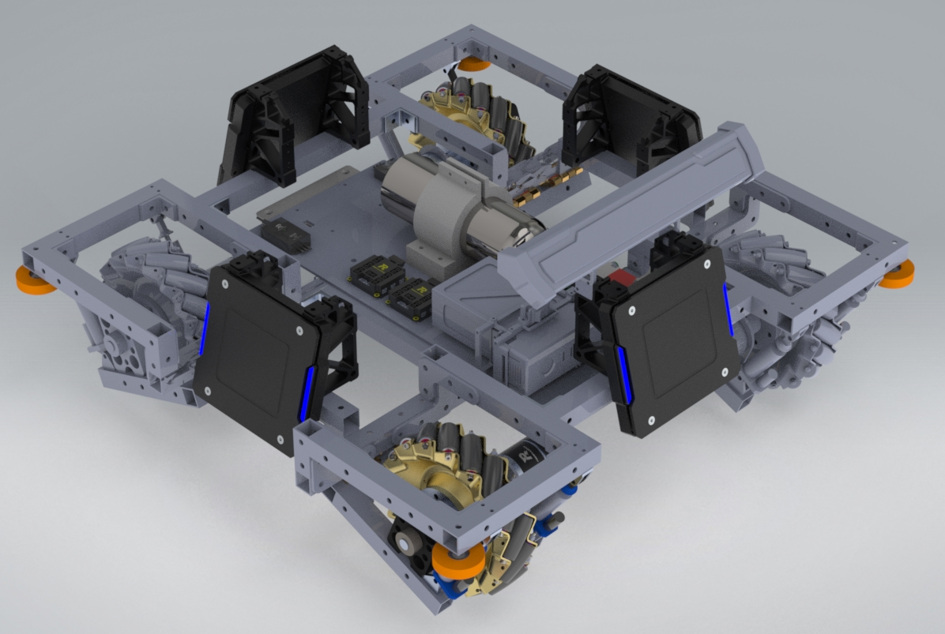
CAD Design - Chassis
Chassis
Capability:
Relatively stable under violent crash
Easy Access of wiring
Roller on corners of chassis to prevent stuck in arena corners
To be improved:
Side bars of suspension module are too low that may get stuck on bumpy road.

Slide 27
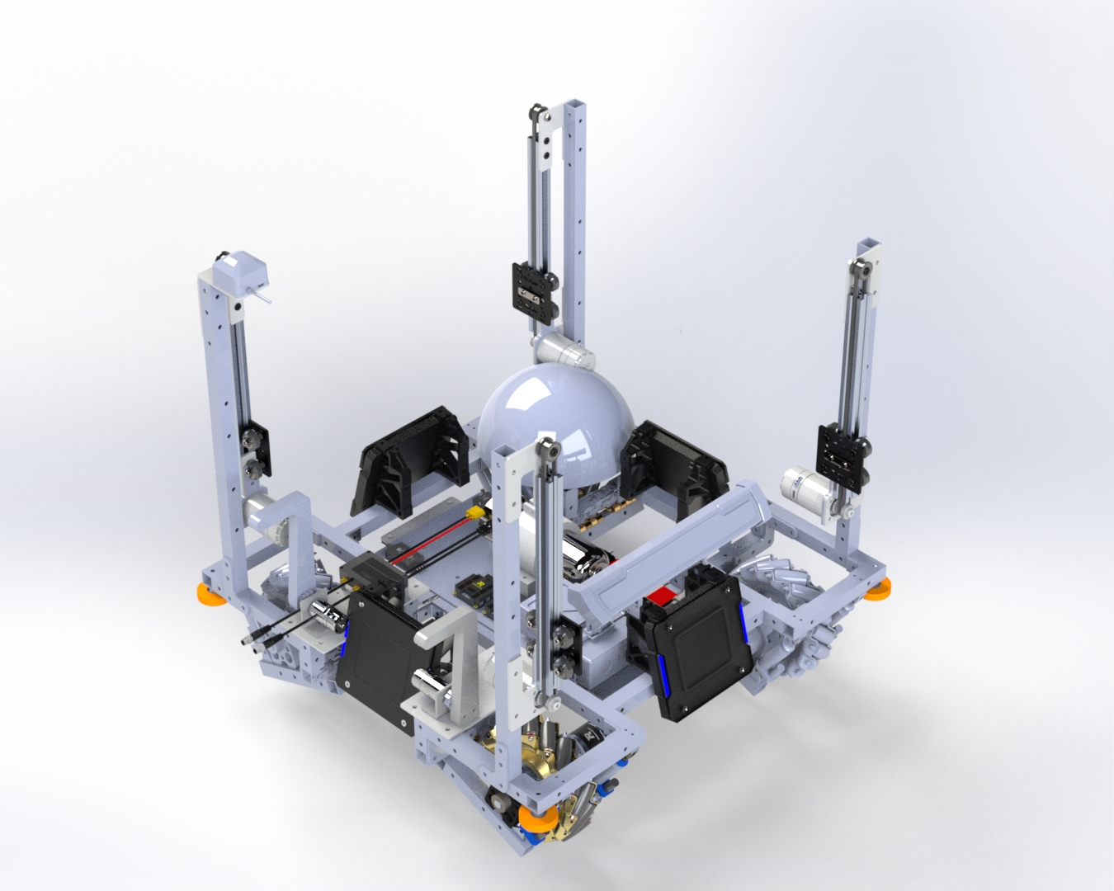
CAD Design - Lifting Mechanism
Lifting Mechanism
Capability:
Can move 200mm vertically which covers the needs in competition
To be improved:
More connections between the 4 vertical modules to improve stability
Add mobility in horizontal direction

Slide 28
CAD Design - Rescue Mechanism
(not tested)
2DMG
Capability:
Drag protective case of infantry and hero
To be improved:
Use one motor with shaft or pneumatic piston

Slide 29
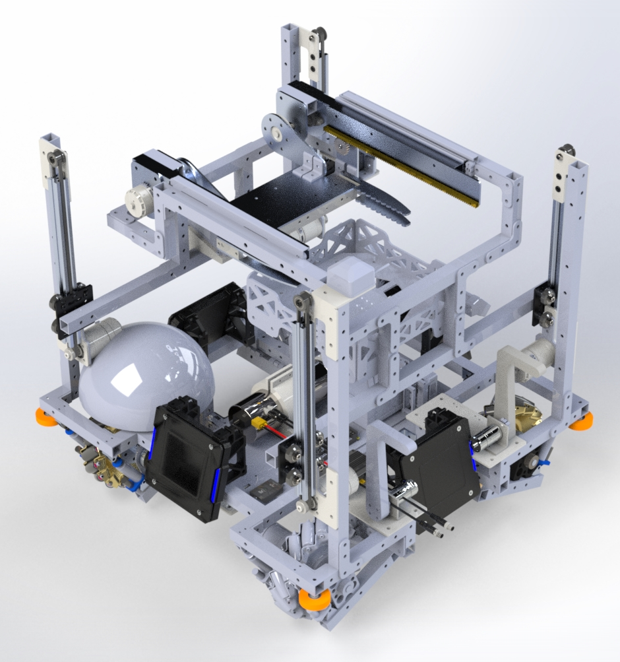
CAD Design - Claw and Mineral Box
Claw and Mineral Box
Capability:
Extend 400mm
Store one mineral in the rear
To be improved:
Adding space between the sides of the claw to have more tolerance for flipping back
Close the grippers tighter

Slide 30
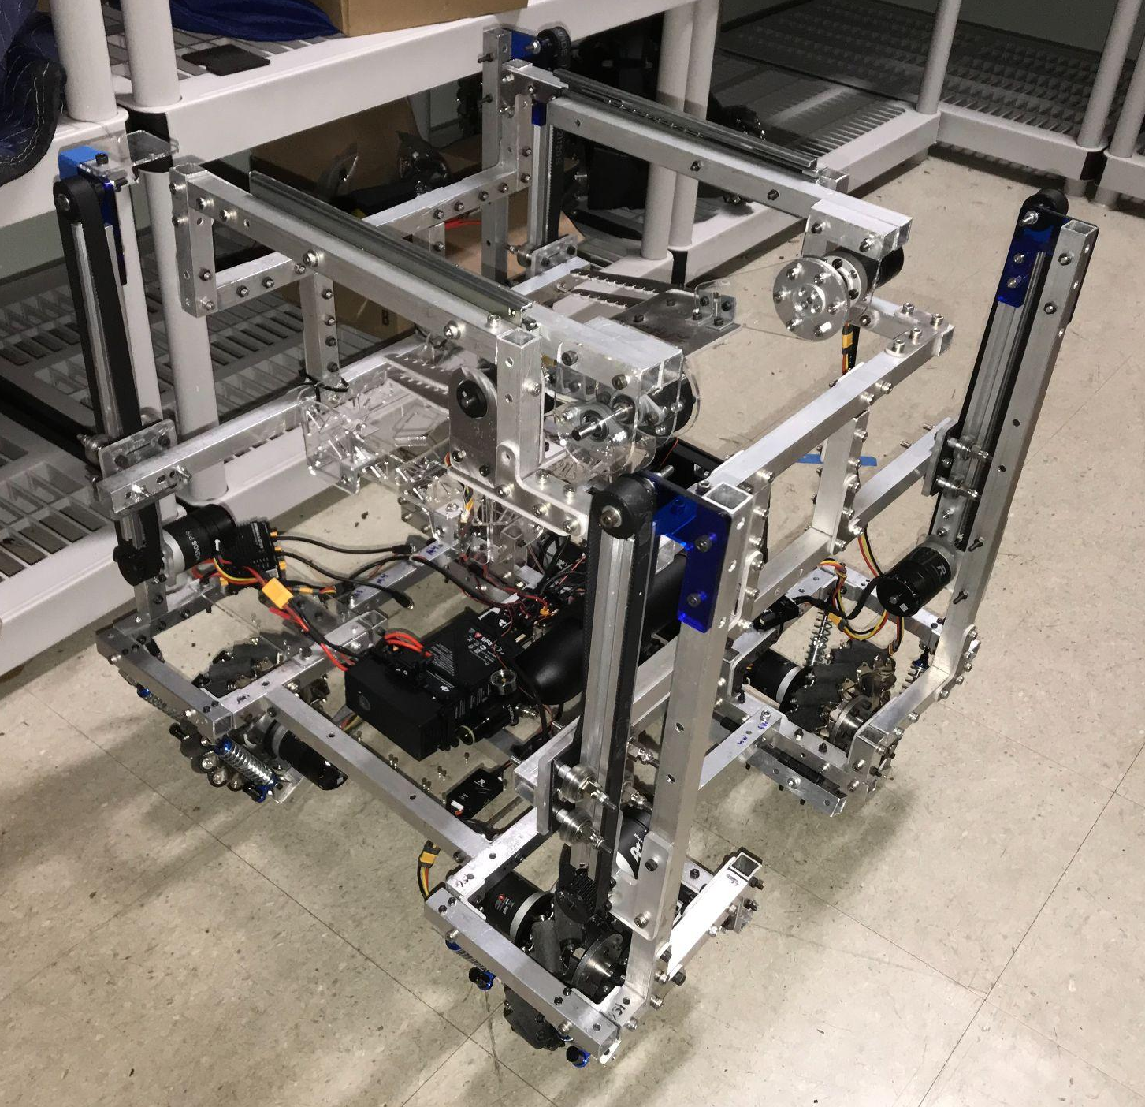
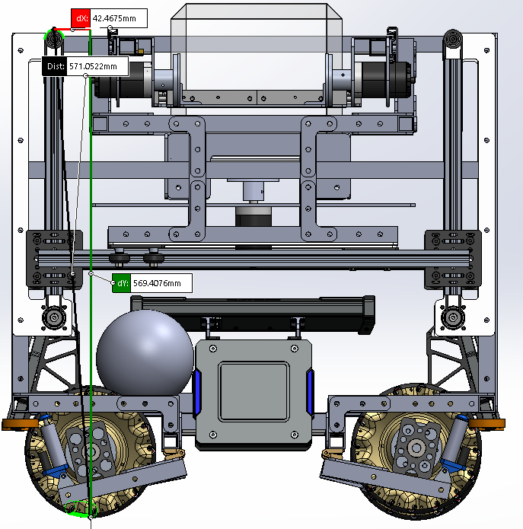
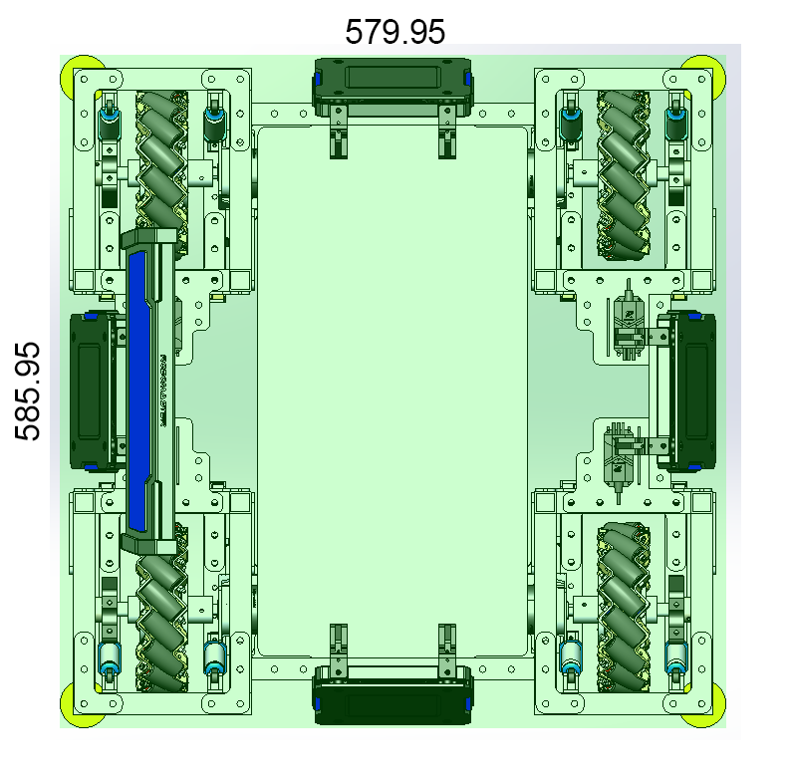
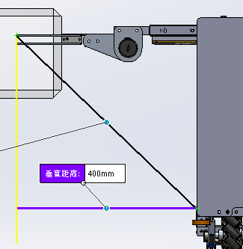
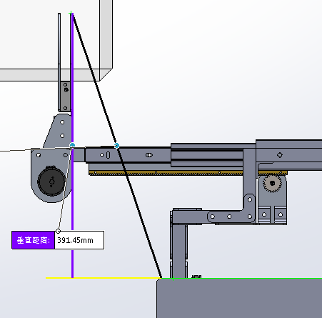
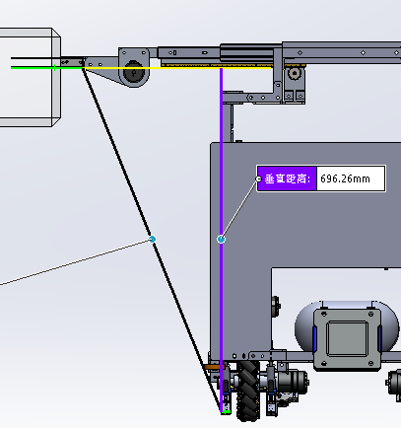
Engineer Prototype

Slide 31
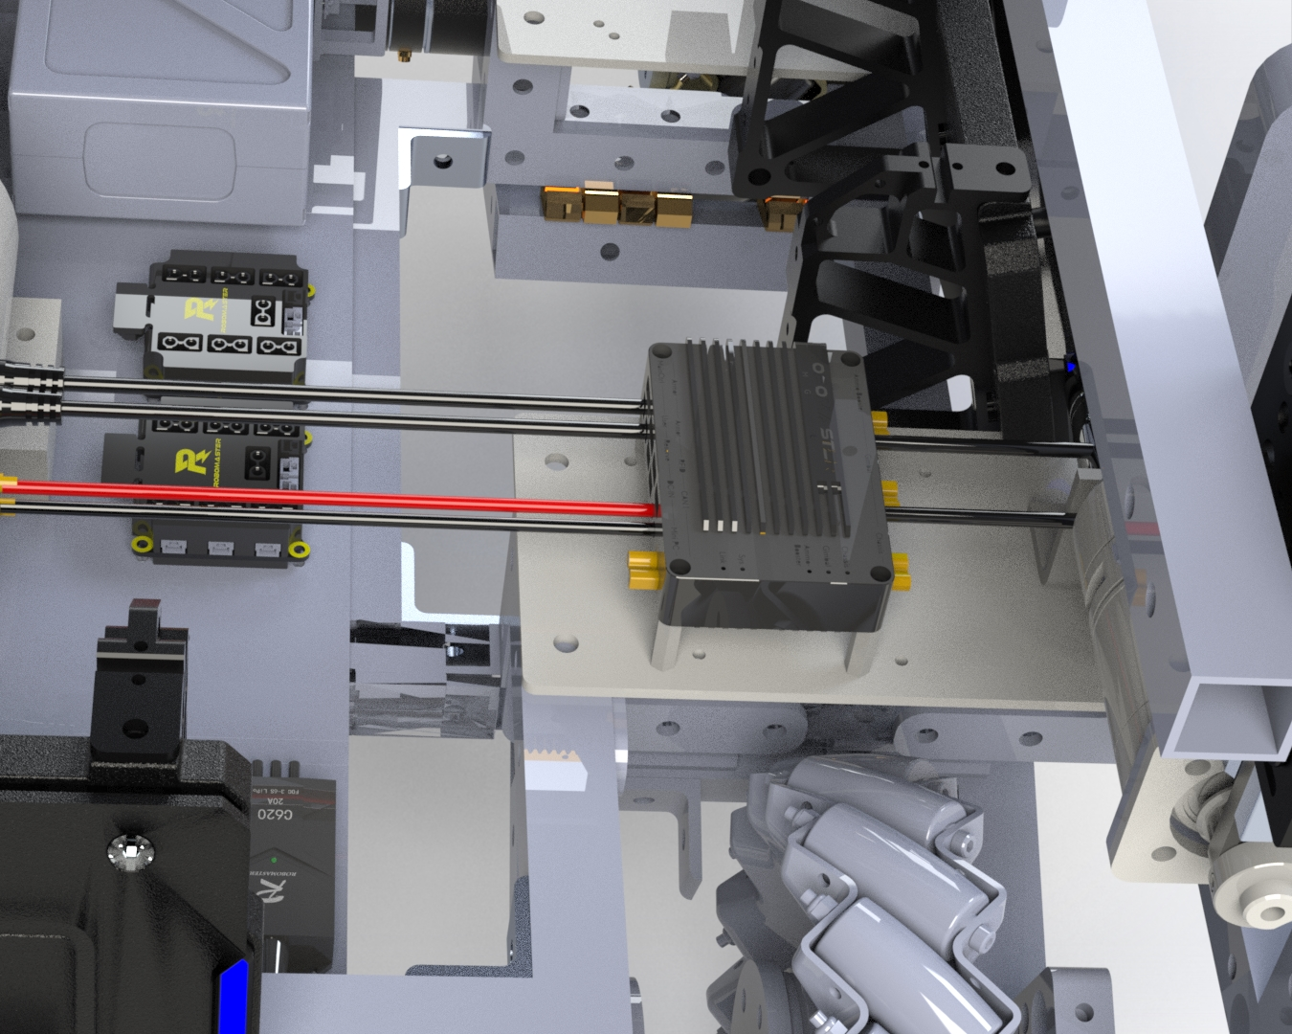
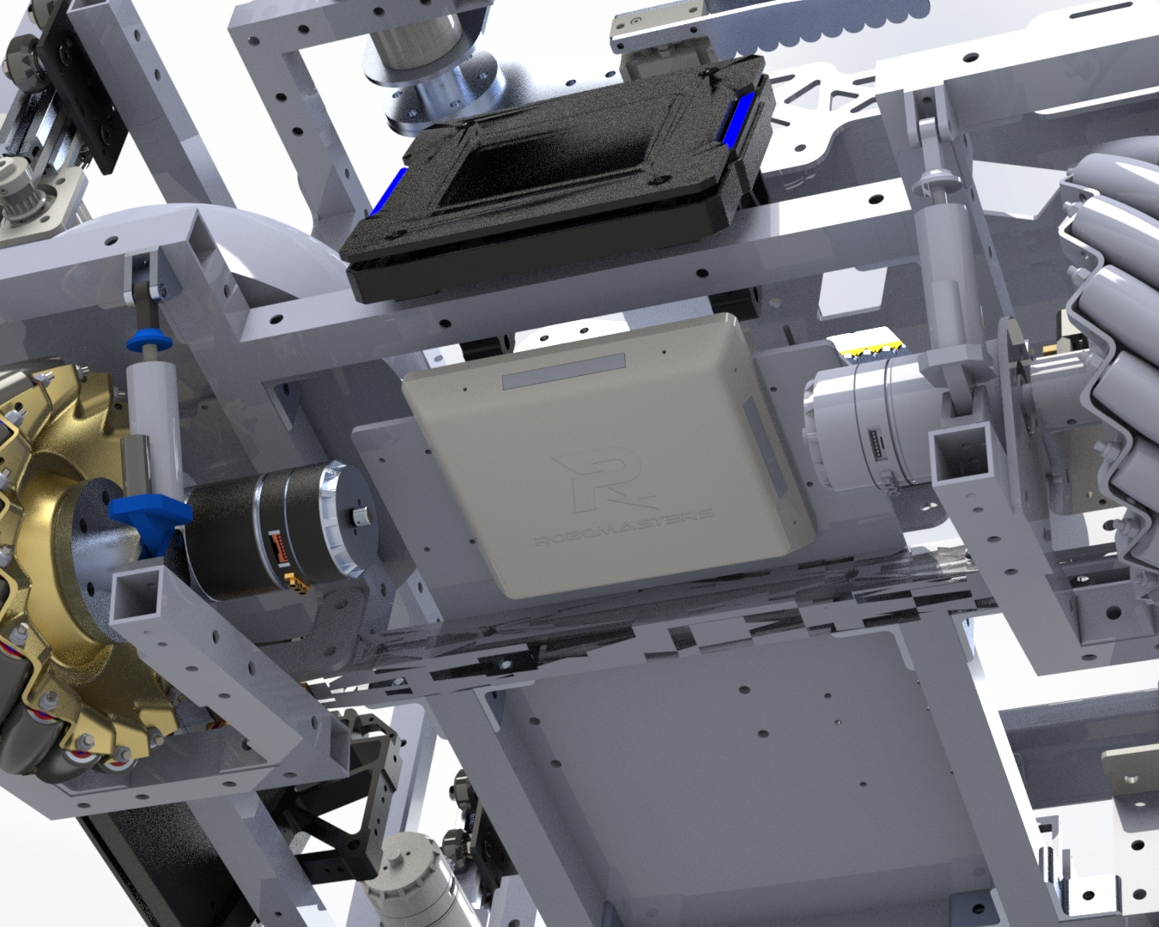
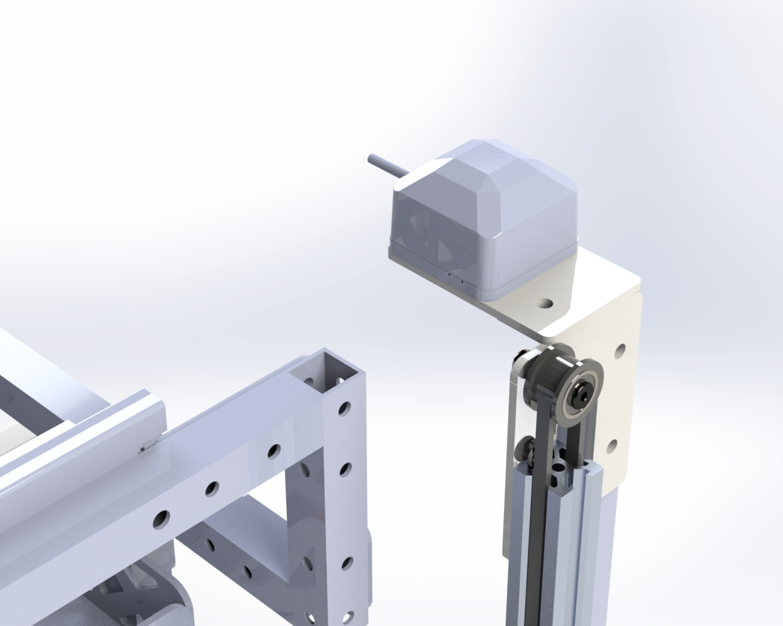
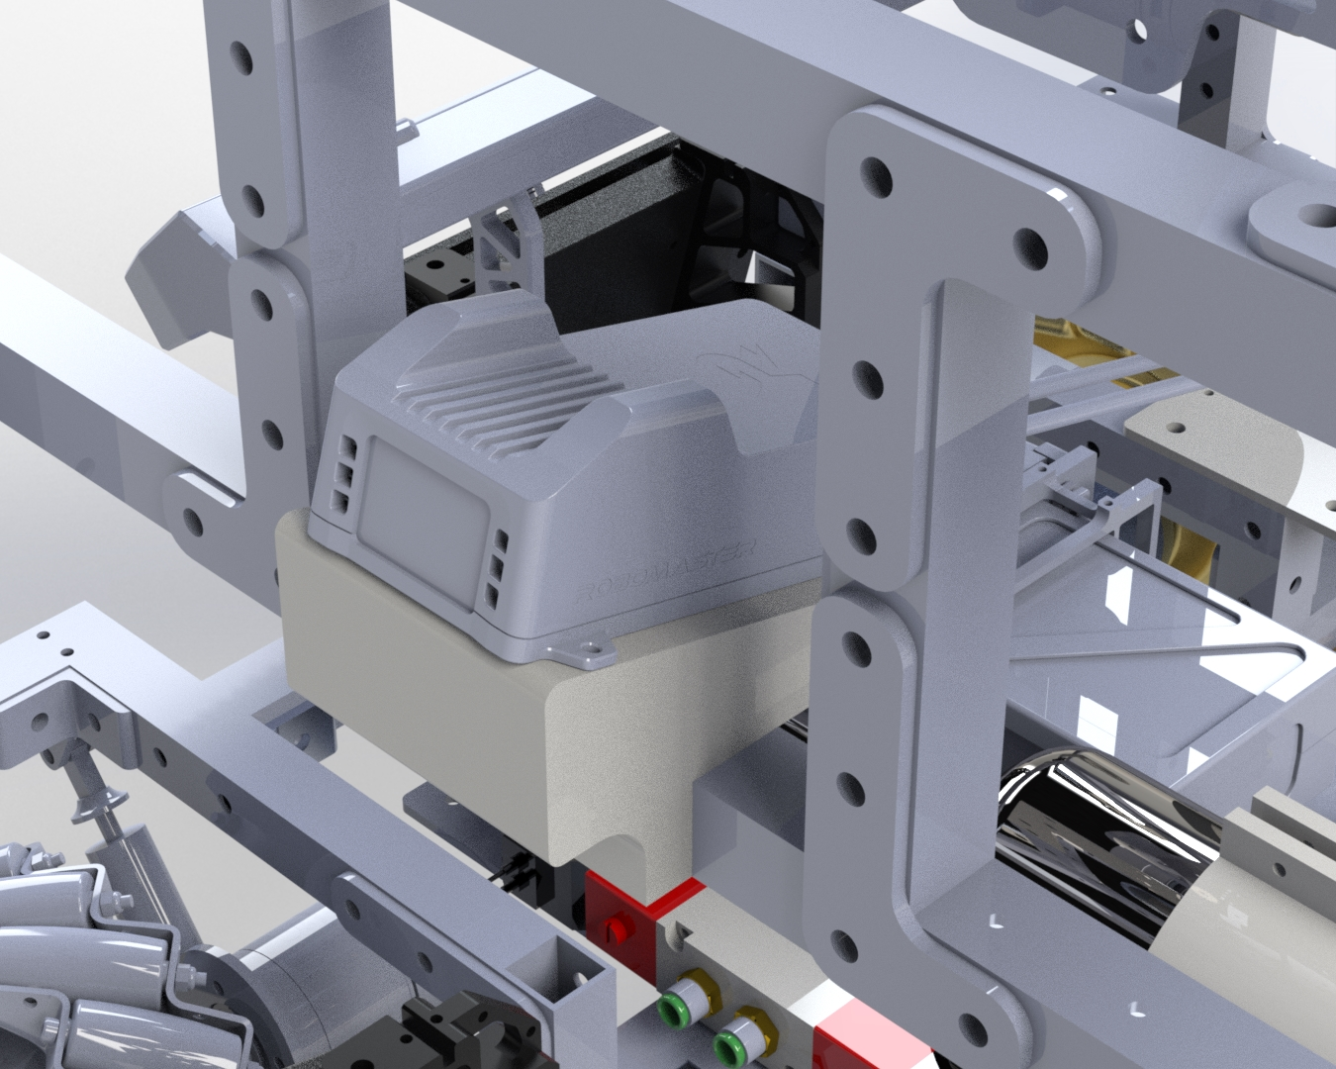
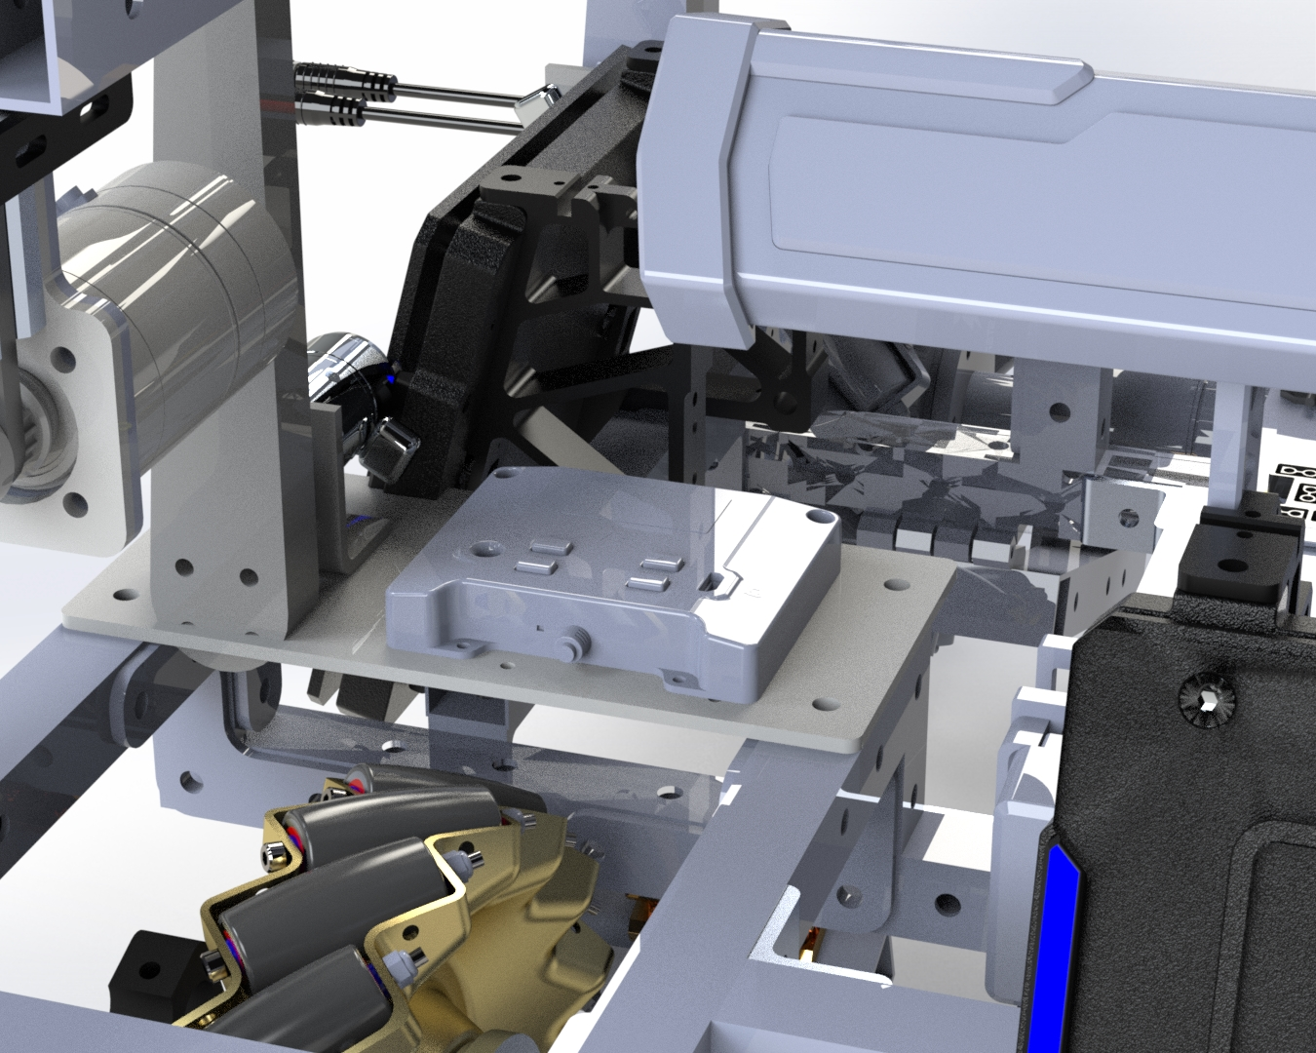
Referee System Showcase
4 armor plates + 1 HP Bar
Power Management Module
RFID
GPS
VTM
Main Control Module

Slide 32















Rescue Mechanism
ESC Center Board 2
Chassis
Engineer Wiring Diagram
M2006 Motor
C610 ESC
C620 ESC
Claw Mechanism
PMM
M2006 Motor
C610 ESC
Video Transmitter
M3508 Motor
ESC Center Board 2
Lifting Mechanism
Main Control Module
RFID
M3508 Motor
C620 ESC
Light Indicator
Positioning Module
C620 ESC
Wire Count Reference
CAN Bus Wire (12)
Battery
Power/Ground Cable (15)
Armor Cable (5)
Aviator Cable (4)
Aviator Cable (4)
M3508 Motor
Small Armor Plate

Slide 33
Drone

Slide 34

CAD Design - Turret
Turret
Capability:
Shoot 17mm balls at 25 m/s
Allows for easy dev board access
To be improved:
Not a lot of space to mount the mini PC
Needs better wire management

Slide 35

CAD Design - Airframe
Airframe
Capability:
Flight time of about 20 minutes
To be improved:
Needs some more mounting holes
Needs better wire management

Slide 36

CAD Design - Cage and Landing Gear
Cage and Landing Gear
Capability:
Can deflect balls away from propellers
Protect propellers in case of a crash
To be improved:
Landing gear legs are not stable
Cage needs more secure mounting to the airframe

Slide 37



Dimensions
1353x1258x529mm LWH

Slide 38

Drone Prototype

Slide 39




Referee System Showcase
Power Management Module
17mm Speed Monitor Module and VTM
Main Control Module
GPS

Slide 40
Dart

Slide 41

CAD Design - Launcher
Dart Launcher
Capabilities
Pitch movement
Yaw rotation
Movement of Dart along linear path
Shooting Dart from flywheels
To be Improved
Testing of dart launcher
Speed of all mechanisms

Slide 42

CAD Design - Dart
Dart
Capabilities
Emit lazer light from tip
Fly with some accuracy to hit target
To be Improved
Testing of dart
Aerodynamics of dart
Self Guidance features

Slide 43
Embedded

Slide 44

General - Remote Control

Slide 45

General - Remote Control

Slide 46


General - Servo

Slide 47

Infantry - BeyBlade Mode

Slide 48

Drone - PID Tuning (Roll)

Slide 49

Drone - PID Tuning (Roll)

Slide 50

Drone - PID Tuning (Yaw)

Slide 51

Drone - Sensor

Slide 52
Computer Vision

Slide 53

Armor Plate Detection

Slide 54


Slide 55



Armor Plate Detection Test

Slide 56
Supercapacitor

Slide 57
Supercapacitor Functionality
Allow our ground robots to temporarily bypass the 80W drive motor power limit to achieve controlled bursts of speed as game situations demand it.
Charge capacitor banks using excess power from the Power Management Module(PMM)
Allow operators to monitor capacitor charge states using HUD displays
Relevant Modules:
Power Control Board
Supercapacitor Bank

Slide 58

Supercapacitor Power System
Generalized wiring diagram

Slide 59

Supercapacitor Power System
Super Capacitor bank board file
Includes passive charge balancing

Slide 60

Supercapacitor Power System
Control Board Schematic
Features:
Capacitor current control
Temperature sensing/lockout
Utilizes pre packaged modules:
Boost converter
Power Management IC

